Slide 1
Unit – 4 (Part IV) Intermediate Code Generation
BSc CSIT 5th Semester
2020
Mid-Western University, Surkhet
Prepared By
Dabbal Singh Mahara

Slide 2
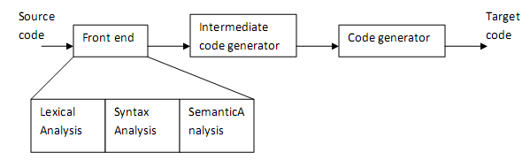
Intermediate Code Generation
In the analysis-synthesis model of compiler, the front end analyzes a source program and creates an intermediate representation, from which the back end generates target code.
The details of source language are confined to front end and details of the target machine to the back end.
With a suitably defined intermediate representation, a compiler for language i and machine j can then be built by combining the front end for language i with the back end for machine j.
Intermediate code is often the link between the compiler’s front end and back end.
Intermediate codes are machine independent codes, but they are close to machine instructions.
Fig. Position of Intermediate Code Generator in Compiler

Slide 3
Why Intermediate Language
Advantages:
Target code can be generated to any machine just by attaching new machine as the back end. This is called retargeting.
It is possible to apply machine independent code optimization to intermediate code in order to optimize the code generation.
IR can modularize the task: Front end is not bothered about machine details and Back end is not bothered about source language.
Have many front-ends into a single back-end – gcc can handle C, C++, Java, Fortran, Ada, ... – each front-end translates source to the same generic language (called GENERIC)
Have many back-ends from a single front-end – Do most optimization on intermediate representation before emitting code targeted at a single machine
It provides intermediate level of abstraction
more details than the source
fewer details than the target

Slide 4
Types of Intermediate Languages
There are three kinds of intermediate representations:
High-level intermediate representations: – closer to the source language; e.g., syntax trees or Directed Acyclic Graph(DAG) – easy to generate from the input program – code optimizations may not be straightforward
Low-level intermediate representations: – closer to target machine; e.g., P-Code, U-Code (used in PA-RISC and MIPS), GCC’s RTL, 3-address code – easy to generate code from – generation from input program may require effort
“Mid”-level intermediate representations: – Java bytecode, Microsoft CIL, LLVM IR, ...

Slide 5
1. Syntax Tree
Each node in a syntax tree represents a construct; the children of the node represent the meaningful components of the construct.
A syntax tree node representing an expression E₁+E₂ has label + and two children representing the subexpressions E₁ and E₂.
We shall implement the nodes of a syntax tree by objects with a suitable number of fields. Each object will have an op fields that is the label of the node.
Additionaly, if a node is a leaf node, an op field has the lexical value for the leaf. A constructor function leaf(op,val) creates a leaf object.
If the node is an interior node, a constructor function node(op, c1,c2,..,ck) creates an object with field op and other k fields.

Slide 6
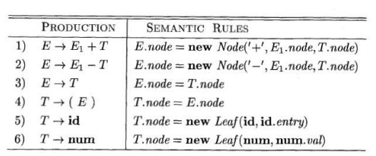
SDD for creating syntax tree
Example: Creating syntax tree for expression: 2-3+4
E
+
E
+
T
-
E
-
T
num
num | 4
T
4
num
num
3
num | 2
num | 3
2

Slide 7

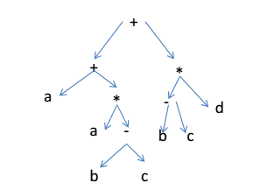
Example 2: Syntax tree

Slide 8

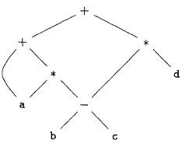
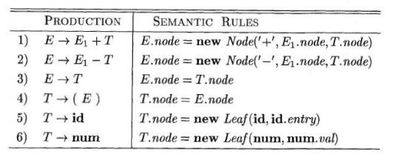
2. DAG
Like syntax tree for an expression, DAG has leaves corresponding to atomic operands and interior nodes corresponding to operators.
The difference is that a node N in DAG has more than one parent if N represents a common subexpression.
All what is needed is that functions such as Node and Leaf above check whether a node already exists. If such a node exists, a pointer is returned to that node.
More compact representation
Gives clues regarding generation of efficient code Example: DAG for expression:

Slide 9
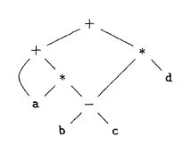
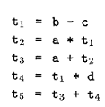
3. Three-Address Code
A three address code is the intermediate representation with at most one operator on the right side of an instruction.
That is, no built-up arithmetic expressions are permitted.
Thus, x+y*z might be translated into the sequence of three address instructions: t₁ = y*z t₂ = x + t₁
where t1 and t2 are compiler generated temporary names.
3AC is close to assembly language, making machine code generation easier.
3AC is easy to generate from syntax trees or DAG. We associate a temporary with each interior tree node.

Slide 10
Forms of 3AC
Assignment statements of the form x := y op z, where op is a binary arithmetic or logical operation.
Assignment statements of the form x := op y, where op is a unary operator, such as unary minus, logical negation
Copy statements of the form x := y, which assigns the value of y to x.
Unconditional statements goto L, which means the statement with label L is the next to be executed.
Conditional jumps, such as if x relop y goto L, where relop is a relational operator (<, =, >=, etc) and L is a label. (If the condition x relop y is true, the statement with label L will be executed next.)
Statements param x and call p, n for procedure calls, and return y, where y represents the (optional) returned value. The typical usage: p(x1, …, xn)
param x1
param x2
…
param xn
call p, n
Index assignments of the form x := y[i] and x[i] := y. The first sets x to the value in the location i memory units beyond location y. The second sets the content of the location i unit beyond x to the value of y.
Address and pointer assignments:
x := &y
x := *y
*x := y

Slide 11
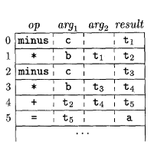
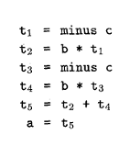
Representation of 3AC in data structure
How to present these instructions in a data structure?
In compiler the instructions in 3AC can be implemented as objects or records with fields for operator and operands. Three such representations are: – Quadruples – Triples – Indirect triples
1. Quadruples • Has four fields: op, arg1, arg2, result • Exceptions: – Unary operators: no arg2 – Operators like param: no arg2, no result – (Un)conditional jumps: target label is the result

Slide 12
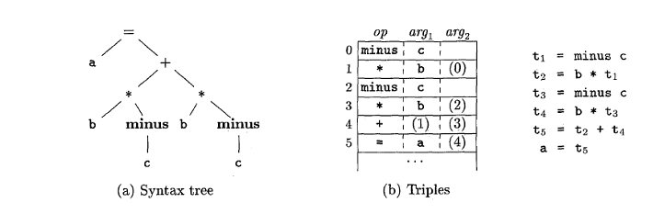
2. Triples
• Only three fields: no result field • Results referred to by its position
(c ) Three address code
Fig. Representation of a = b * - c + b * - c

Slide 13
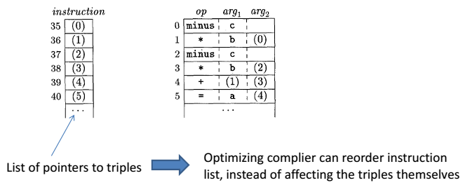
3. Indirect Triples
When instructions are moving around during optimizations: quadruples are better than triples.
Indirect triples solve this problem.
Indirect triples consists of list of pointers to triples rather than a listing of triples themselves. With this optimizing compilers can move an instruction by reordering the instruction list without affecting the triples themselves.

Slide 14
3AC for program constructs
Program consists of assignment statements like a=b op c or control statements like if-then-else, while loop or for statements.
This section deals with generation of three address code for assignment statement and control statements.
1. Three-address code for assignment statement
The three-address code for an assignment statement S is given in following SDD. The attributes S.code and E.code denote the three-address code for S and E respectively.
Attribute E.addr denotes the address that will hold the value of E. This address can be a name, a constant, or a compiler-generated temporary.
The production E -> id, in SDD, when an expression is a single identifier, say x, then x itself holds the value of the expression. The semantic rules for this production define E.addr to point to the symbol table entry for this instance of id. Let top denote the current symbol table. Function top.get ( )retrieves the entry when it is applied to id.lexeme of id. E.code is set to empty string.
For E -> (E₁), the translation of E is the same as that of the subexpression E_{1.} Hence, E.addr eauals E₁.addr and E.code = E₁.code.
For E->E₁ + E₂ , generate code to compute value of E from the values of E₁ and E₂. Values are computed into newly generated temporary names.
A sequence of temporary names is created by new Temp();
The gen( ) function is to build an instruction and return it.

Slide 15
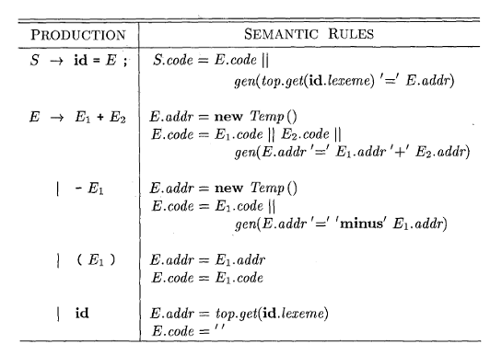
3AC for Assignment statement with expressions

Slide 16
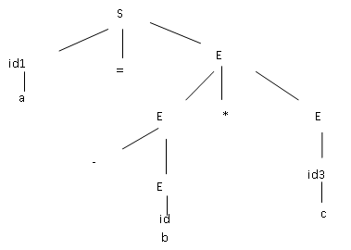
Example: Generate three address code or the following arithmetic expression: a = - b * c
S.code = t₁ = -b t₂ = t₁ * c
a = t₂
E.addr = t₂
E.code= t₁ = -b t₂ = t₁ * c
E.addr = t₁
E.code= t₁ = -b
E.addr = c
E.code = ‘ ’
E.addr = b
E.code = ‘ ’
Three Address code:
t₁ = -b
t₂ = t₁* c
a = t₂
fig. Parse tree for the expression a= -b *c

Slide 17
3AC generation for Array references
Elements of array are stored in consecutive memory location.
In C and Java, the array elements are numbered 0,1,.........., n-1, for array with n elements.
If width of each element is w then the ith element of the array can be accessed at:
base + i * w ........ ( 1)
where base is the base address of array or the address of the 1st element of array.
Example: Let A[10] be an array of 10 elements. Let size of each element be 2 i.e., w =2 and the array is stored from memory location 1000 i.e. base address=1000.
3rd element of array is at address = 1000 + 3 * 2 = 1000 + 3 * 2 = 1000 + 6=1006
A[0] | A[1] | A[2] | A[3] | A[4] | A[5] | A[6] | A[7] | A[8] | A[9]

Slide 18
3AC generation for Array references
More generally, the array elements need not be started at 0. In one dimensional array, the array elements are numbered low, low+1, low+2,............, high and base is the relative address of A[low].
The address of A[i] can be rewritten as: base + (i-low) * w ..............(2)
Formula (2) can be written as: i * w + base – low * w = i * w + c , where c = base – low * w.
All the components in c are known before compilation hence they can be pre-computed and stored. This reduces the time taken to generate address of ith element.
We assume that c is saved in the symbol table entry for A, so the relative address of A [ i ] is obtained by simply adding i * w to c.

Slide 19
One Dimensional Array Reference: Example
A: array [10 ... 20] of integers;
 |  |  | ... |  | ...
base
i
width of the array element w
low
x : = A[ i ]
= base + (i – low) * w = i *w + c
where, c = base – low * w with low = 10; w =4
x

Slide 20
In case of multi-dimension array like matrix, elements are either stored as Row Major or Column Major. C language and Pascal uses row major storage where as Fortran language uses column major storage.
Example: Consider Array A[3,3] with elements:
(0,0) | (0,1) | (0,2)
(1,0) | (1,1) | (1,2)
(2,0) | (2,1) | (2,2)
Row Major | (0,0) | (0,1) | (0,2) | (1,0) | (1,1) | (1,2) | (2,0) | (2,1) | (2,2)
Colum Major | (0,0) | (1,0) | (2,0) | (0,1) | (1,1) | (2,1) | (0,2) | (1,2) | (2,2)
Address of element A [i, j] in row major storage is given by the expression as follows.
A[i,j] = base + ((i - low1) * n2 + j - low2) * w, ................. ( 3)
where low1 and low2 are lower bounds of i & j and n2 defines the number of columns. w defines the size of each element.
Expression can be written as:
A[i,j] = (( i * n2) + j) * w) + ( base – (( low1 * n2) + low2) * w ) .......... (4)
The second part of the Expression (4) can be pre-computed by knowing the value of base, low1, low2 and w. This helps in faster generation of address for A[i,j].

Slide 21
Example: 2D array referencing
A : array (1..2,1..3) of integer;
... = A[i,j] = base_{A} +(i-low₁) * n₂ + j-low₂) *w
= ((i*n₂) +j) *w + c
Where c = base_{A} –((low₁ *n₂)+low₂) * w
with low₁ = 1, low₂ =1, n2 = 3 , w =4
Three- address code
t1 = i* 3
t2 = t1 +j
t3 = t2 * 4
t4 = c
t5 = t4 [t3]
..... = t5

Slide 22
Translation of Array references
The main problem of generating code for array referencesis to relate address calculation formula in the grammar for array references.
Let nonterminal L generate an array name followed by a sequence of index expressions: L -> L [ E ] | id [ E ]
In this translation scheme gen( ) function builds an instruction and incrementally emits it into the stream of generated instructions.
The nonterminal L has three synthesized attributes:
L.addr: denotes a temporary that is used while computing the offset for the array reference generated by L.
L.array: is pointer to a symbol table entry for the array name. The base address of the array – the address of its 0th element, say, L.array.base is used to determine the actual l-value of an array refrence after all the index expressions are analyzed. The location for array reference is therefore L.array.base[L.addr].
L.type is the type of the subarray generated by L. For any type t, we assume that its width is given by t.width and t.elem gives the element type.
The translation scheme is shown below:

Slide 23
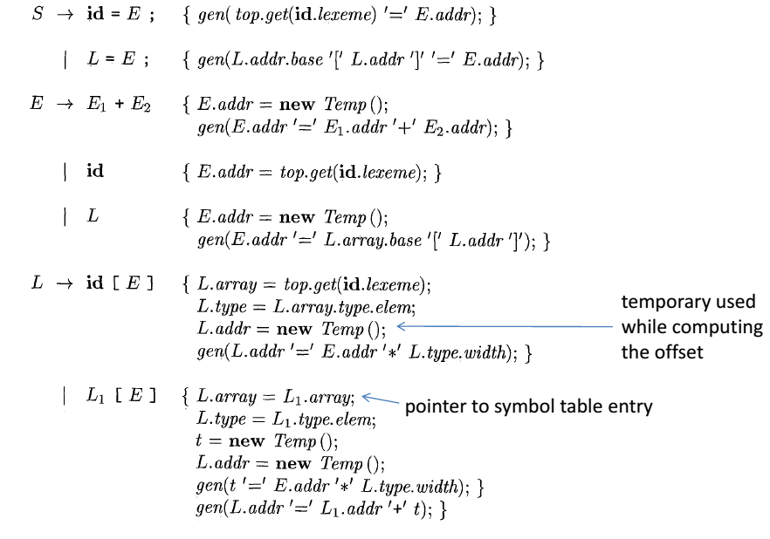
Translation of Array references

Slide 24
Example: Compute 3AC for expression c+a[i][j], where c, i and j are all integers and a is 2x3 integer array.
E. addr= t₅
+
E . addr = t₄
E.addr = c
L.array = a
L.type = integer
c
L.array = a
L.type = array (3, integer)
L . addr = t₃
E
L.addr = t₁
[
. addr =j
]
j
a
[
E
]
. addr =i
a.type
= array(2, array(3, integer))
Three Address Code
t₁ = i * 12
t₂ = j *4
t₃ = t₁ + t₂
t₄ = a [ t₃]
t₅ = c + t₄
i
Fig. Annotated Parse Tree for c + a[ i ][ j ]

Slide 25
Flow-of- control statements
Control statements are used to alter the sequential flow of execution.
Some the control statements are if-then-else statement, while statement.
S -> if (E ) S₁
S -> if ( E ) S₁ else S₂
S -> while ( E ) S₁
S -> do S₁ while ( E )
Three Address Code for if-then, if-then-else, while do statements can be generated using the translation rules given in following slides.
In the translation rules, both S and E have a synthesized attribute code, which gives the trasnslation into three-address instructions.
For simpilicity, translations S.code and E.code are built up as string using SDD.
The translation of S -> if (E) S₁ consists of E.code followed by S₁.code as shown in figure.

Slide 26
Three Address Code generation for if then statement
to E. true
E.code
to E. false
Statement Translation rules
S->if E then S1 E.true = newlabel();
E.false = S.next;
S1.next = S.next;
S.code = E.code || label(E.True, ‘:’)|| S1.code
E.true :
S₁.code
E.false :
...
Example: Generate 3 address code for the statement: if a>b then x =y +z.
Ans:
3AC for the given statement is:
if a>b then goto L1
goto L2
L1: t1 = y + z
x = t1
L2: ....

Slide 27
Three Address Code generation for if then else statement
Production Semantic Rules
S->if E then S1 else S2 E.true = newlabel();
E.false = newlabel();
S1.next = S.next;
S2.next = S.next;
S.code = E.code || label(E.True, ‘:’)||
S1.code || gen(‘GOTO’, S.next) ||
label(E.false, ‘:’) || S2.code
Example: Generate 3 address code for the statement: if a>b then x =y +z else x = y-z
The three address code is given below:
if a>b then goto L1
goto L2
L1: t1= y+z
x =t1
goto L3 L2: t1 = y-z
x = t1 L3: ............

Slide 28
Three Address Code generation for while do statement
S.code three-address code for evaluating S
S.begin label to start of S
S.next label to end of S
production Semantic rules
S->while E do S1 S.begin = newlabel();
E.true = newlabel();
E.false = S.next
S1.next = S.begin
S.code= label(S.begin ‘:’) || E.code || label(E.true’:’) || S1.code || gen(‘GOTO’ S.begin)

Slide 29
Example 1: Generate 3 address code for the statement: while a>b do x = y +z.
The three address code is given below:
L1: if a> b then goto L2
goto L3
L2: t1 = y+z
x = t1 goto L1
L3: .......
Example 2: Generate 3 address code for the statement:
i = 2 * n + k
while i do
i = i – k
The three address code is given below:
t1 =2
t2 = t1 *n
t3 = t2 +k
L1: if i =1 then goto L2
goto L3
L2: t4 = i-k
i = t4
goto L
L3: .......

Slide 30
Example 3: Generate 3AC for the statement:
while a<b do
if c< d then
x = y + z
else
x = y – z
Solution:
The three address code will be as follows
L1: if a<b then GOTO L2
GOTO LNEXT
L2: if c<d then GOTO L3
GOTO L4
L3: t1 = y + z
x = t1
GOTO L1
L4: t1= y - z
x = t1
GOTO L1
LNEXT:

Slide 31
Example 4: Generate 3AC for the statement:
c =0
do
if (a< b)
x++
else
x- -
c+ +
while ( c < 5 )
Alternate Method:
c = 0
L1: if ( a<b ) GOTO L2
GOTO L3
L2: t₁ = x + 1
x = t₁
GOTO L4
L3: t₂ = x -1
x = t₂
L4: t₃ = c +1
c = t₃
if ( c <5) GOTO L1
----------
Solution:
The three address code is given below:
c =0
if (a < b) GOTO (4)
GOTO (7)
t₁ = x + 1
x = t₁
GOTO (9)
t₂ = x -1
x = t₂
t₃ = c +1
c = t₃
if ( c<5) GOTO (2)
₋₋₋₋₋₋₋₋₋₋₋₋₋₋₋₋₋₋₋₋₋₋₋₋

Slide 32
Example 5: Generate three address code for following c program
int a[10], b[10], dot_product, i;
dot_product = 0;
for ( i =0 ; i < 10 ; i++ ) dot_product += a[i] * b[i];
Intermediate Code:
dot_product = 0;
i =0;
L1: if (i >=10) GOTO L2
t1 = addr(a) // c = base – low* w = base
t2 = i * 4
t3 = t1[t2]
t4 = addr(b)
t5 = i * 4
t6 = t4[t5]
t7 = t3 + t6
t8 = dot_product + t7
dot_product = t8
t9 = i + 1
i = 19
GOTO L1
L2: -------------

Slide 33
Example 6 : Generate three address code for following c program
int a[10], b[10], dot_product, i;
int *a1, *b1;
dot_product = 0;
a1 =a; b1 = b;
for ( i =0 ; i < 10 ; i++ ) dot_product += *a1++ * *b1++;
Intermediate Code:
dot_product = 0;
a1 = &a
b1 = &b
i =0;
L1: if (i >=10) GOTO L2
t3 = *a1
t4 = a1 + 1
a1 = t4
t5 = *b1
t6 = b1 + 1
b1 = t6 +1
t7 = t3 + t5
t8 = dot_product + t7
dot_product = t8
t9 = i + 1
i = 19
GOTO L1
L2: -------------

Slide 34
Logical Expression
Logical operators are mainly used in flow control statements like if then else, while-do and repeat until.
not operation has the highest precedence-level followed by and and or is at least precedence level.
Logical expressions always results in values either true or false.
True can be treated as non zero or non negative or 1 value. Whereas false may be 0 or negative value.
Production Translation rules
E → E1 or E2 E1.true = E. true
E1. false = newlabel( ) E2.true = E.true
E2.false = E. false
E.code = E1.code || label (E1.false) || E2.code
E → E1 and E2 E1.true = newlabel ( )
E1. false = false E2.true = E.true
E2.false = E. false
E.code = E1.code || label (E1.true) || E2.code

Slide 35
SDD for translation of Boolean Expression to 3AC
E → not E1 E1.true = E. false
E1. false = E.true E.code = E1.code
E → E1 rel E2 E.code = E1.code || E2.code || gen(‘if’ E1.addr rel.op E2.addr ‘goto’ E.true) || gen (‘goto’ E.false)
E → ( E1 ) E.value = E1.value
E → true E.code = gen(‘goto’ E.true)
E → false E.code = gen(‘goto’ E.false)
Examples: Generate 3 AC from following statement: a or b and not c.
The 3AC for the above expression will be as follows:
t1 = not c
t2 = b and t1
t3 = a or t2

Slide 36
Example: consider the following statement and translate it into three address codes. if (x < 100 || x > 200 && x != y ) x = 0;
Three address-code:
if x < 100 goto L2
goto L3
L3: if x > 200 goto L4
goto L1
L4: if x != y goto L2
goto L1
L2: x = 0
L1: ......

Slide 37
Three address code for procedure call
S → call id ( Elist ) { for each item p on queue do
produce (‘param’ p);
produce(‘call’ id.value |queue|) }
Elist → Elist , E { append E.value to the end of queue }
Elist → E { initialize queue to contain only E.value }
Example: 1

Slide 38
Example 2
Consider the statement: n = f ( a [ i ] )
where a is array of integers f is function from integers to integers.
Three Address Code:
t1 = i * 4
t2 = a [ t1 ]
param t2
t3 = call f,1
n = t3

Slide 39
Example: 3
int dot_product ( int x[ ] , int y [] )
{
int d, i;
d =0;
for ( i= 0; i<10;i++
d += x[i] * y[i];
return d;
}
int main()
{
int p, int a[10]; int b[10];
p = dot_product ( a, b);
}
Intermediate code
funct begin main
param a
param b
p = call dot_product, 2
func end
intermediate Code:
func begin dot_product
d =0
i=0
L1: if (i>=10) goto L2
t1 = addr(x)
t2 = i * 4
t3 = t1[t2]
t4 = addr(y)
t5 = i * 4
t6 = t4[t5]
t7 = t3 + t6
t8 = d + t7
d= t8
t9 = i + 1
i = 19
goto L1
L2: return d
func end

Slide 40
Example 4: Write 3AC for the following code:
int fact ( int n)
{
if ( n== 0 ) return 1;
else return ( n* fact(n-1));
}
Intermediate Code:
func begin fact
if (n==0) goto L1
t1 = n-1
param t1
t2 = call fact, 1
t3 = n * t2
return t3
L1: return 1
func end

Slide 41
Thank You !

